Slide 1
LENDING CLUB CASE STUDY
Presented by Shebli Yusuf and Lavanya M

Slide 2
Lending Club
Being one of the world’s largest lending firm, We aim at providing the best Loan rates based on our customers. We deal with Personal, Financial, Medical, and Educational loans and much more to carter your needs and provide the best service through out the tenure.
The objective of this EDA is to find out the driving factors for the defaulting on the loan application thereby eliminating the possibility of loaning a possible defaulter which in turn saves the company from the financial risk(s) incurred.

Slide 3
How is this EDA presented?
DATA CLEANSING
DATA ANALYSIS
DATA UNDERSTANDING
Cleaning the given data by eliminating various factors not relevant.
Understanding the data using the data dictionary
Analyzing the data and effectively bringing out valuable insights.

Slide 4
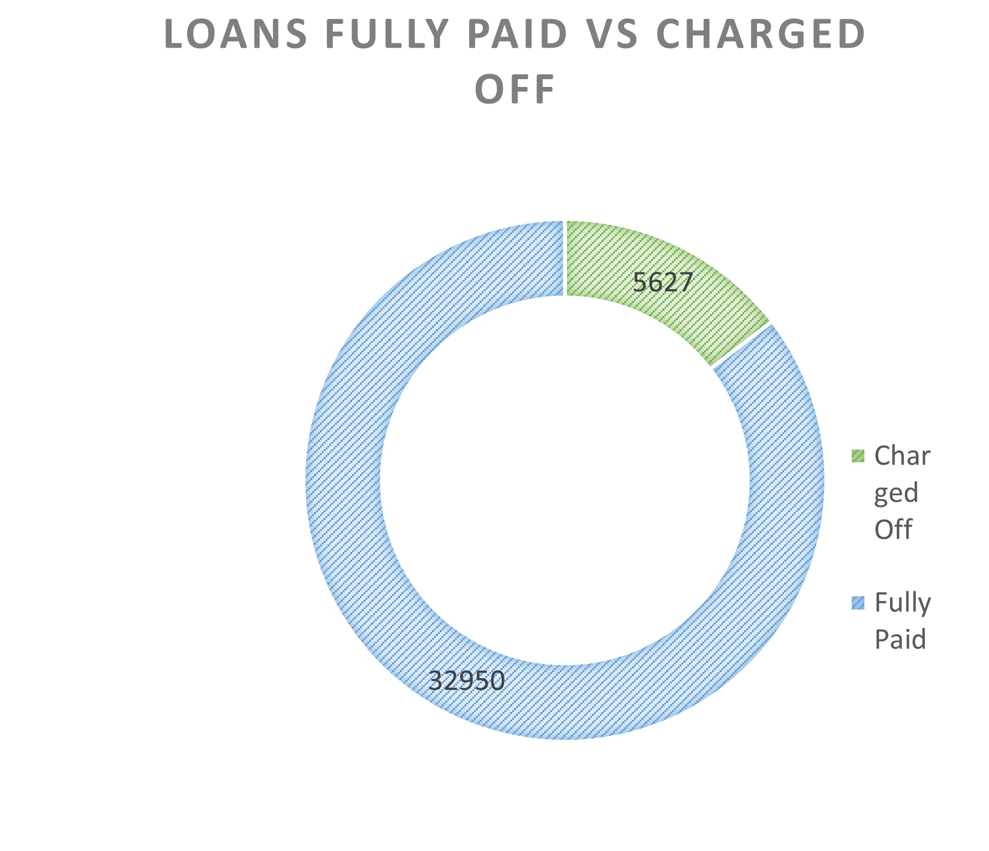
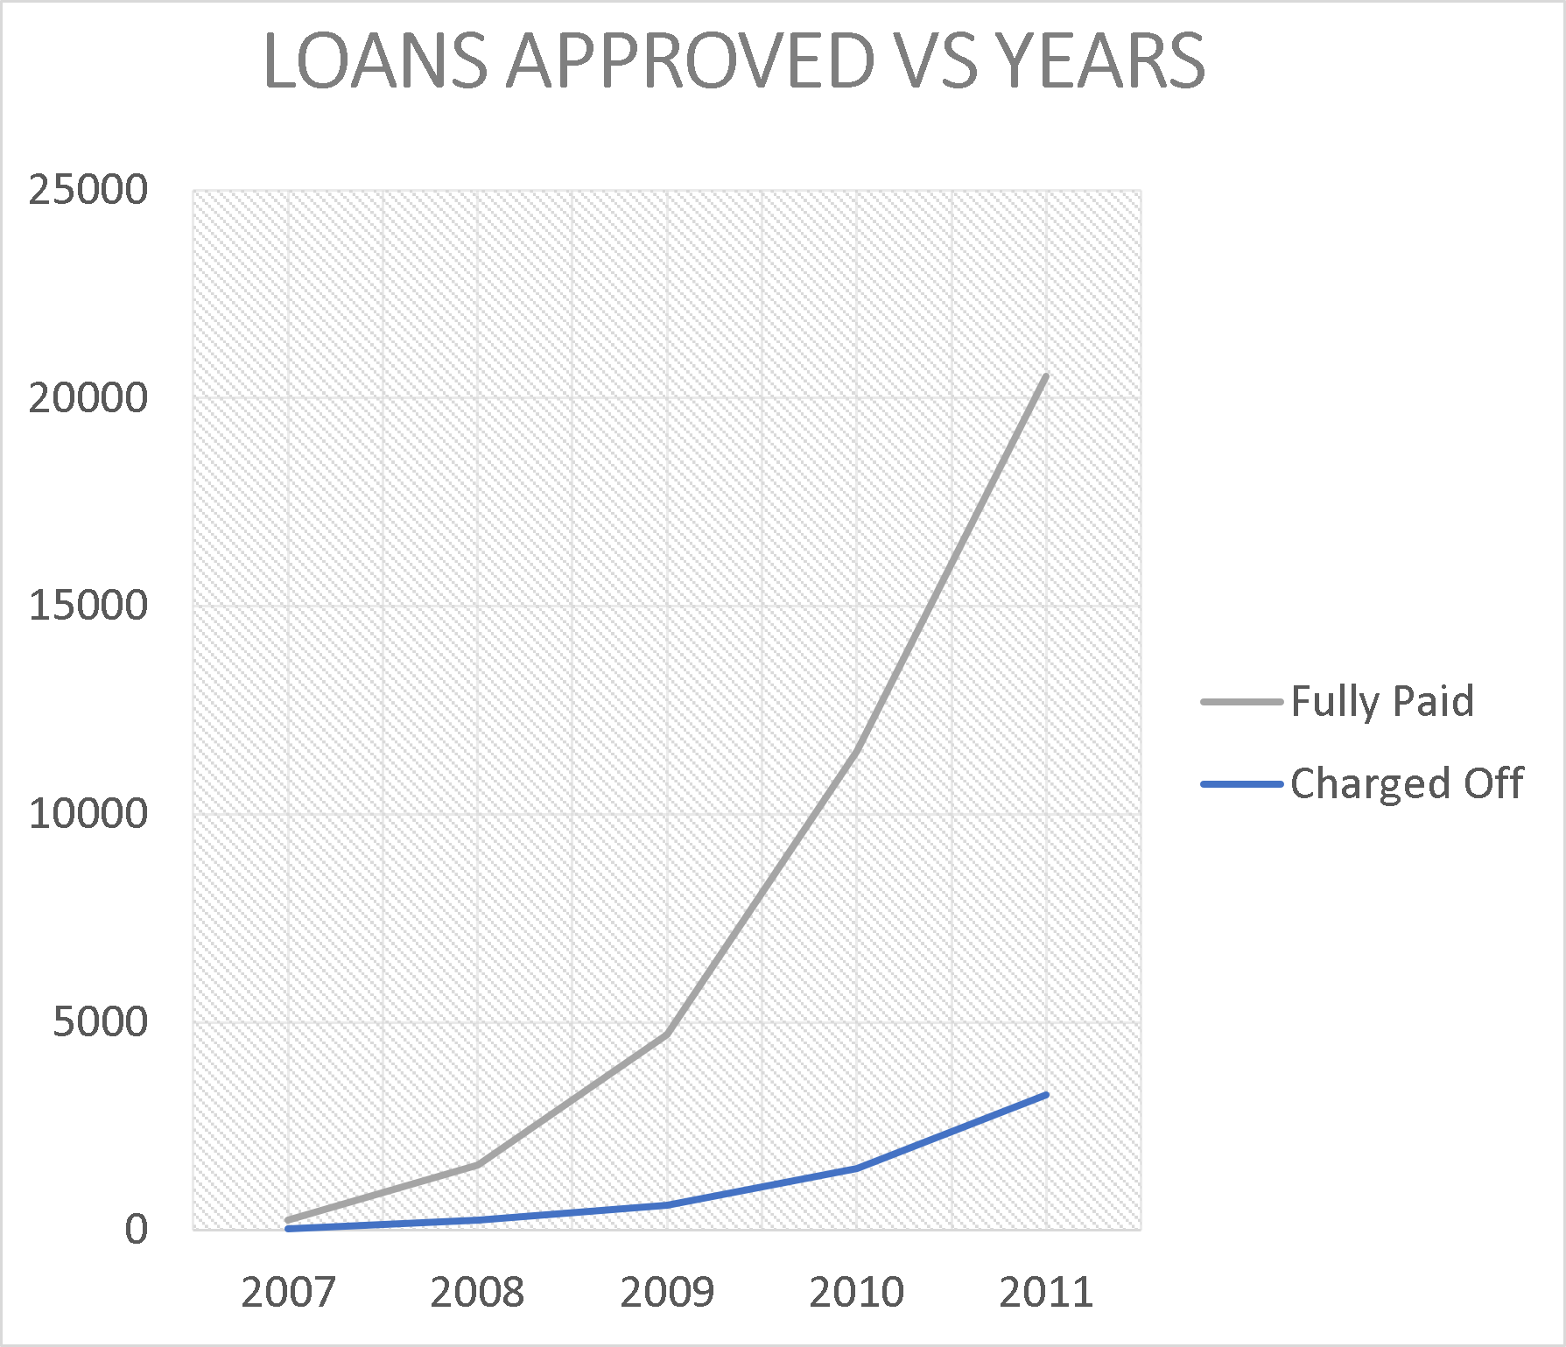
DATA ANALYSIS
As we can see close to 17% of the total loans included in this study are charged off.
As we look at the trend as we move forward through the years the number of customers who are defaulting are drastically reduced.

Slide 5
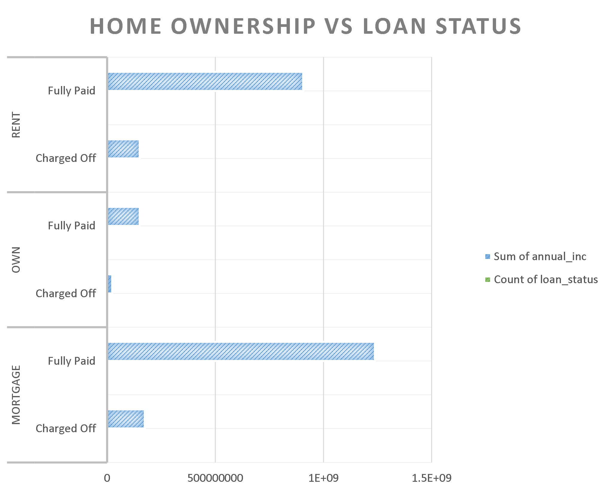
DATA ANALYSIS - HOME OWNERSHIP
We see here that the trend usually is that most of the customers applying for the loans are either Rented or are having Mortgaged Homes.
We also see that the possibility of defaulting is less for the customers with own home.

Slide 6
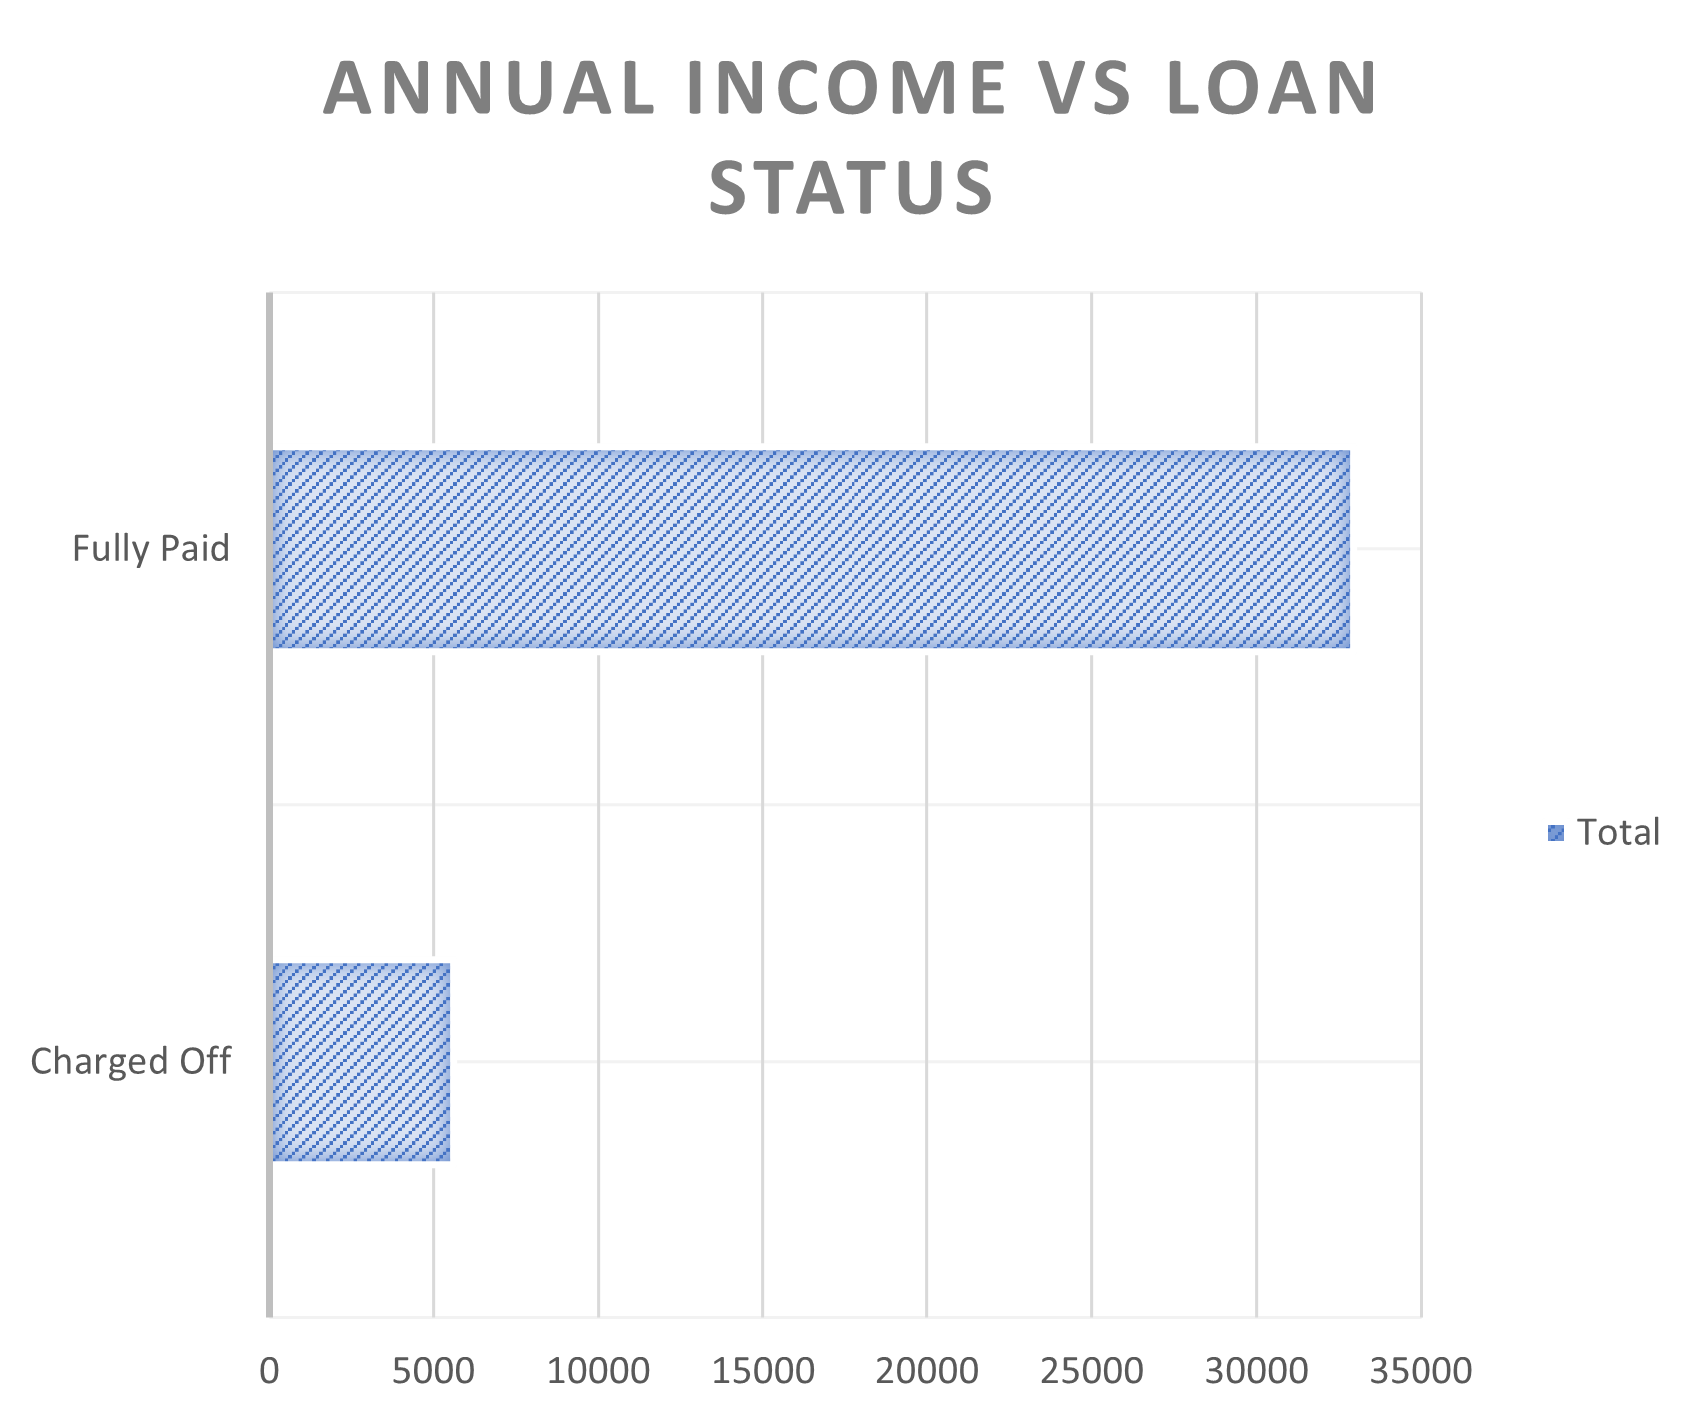
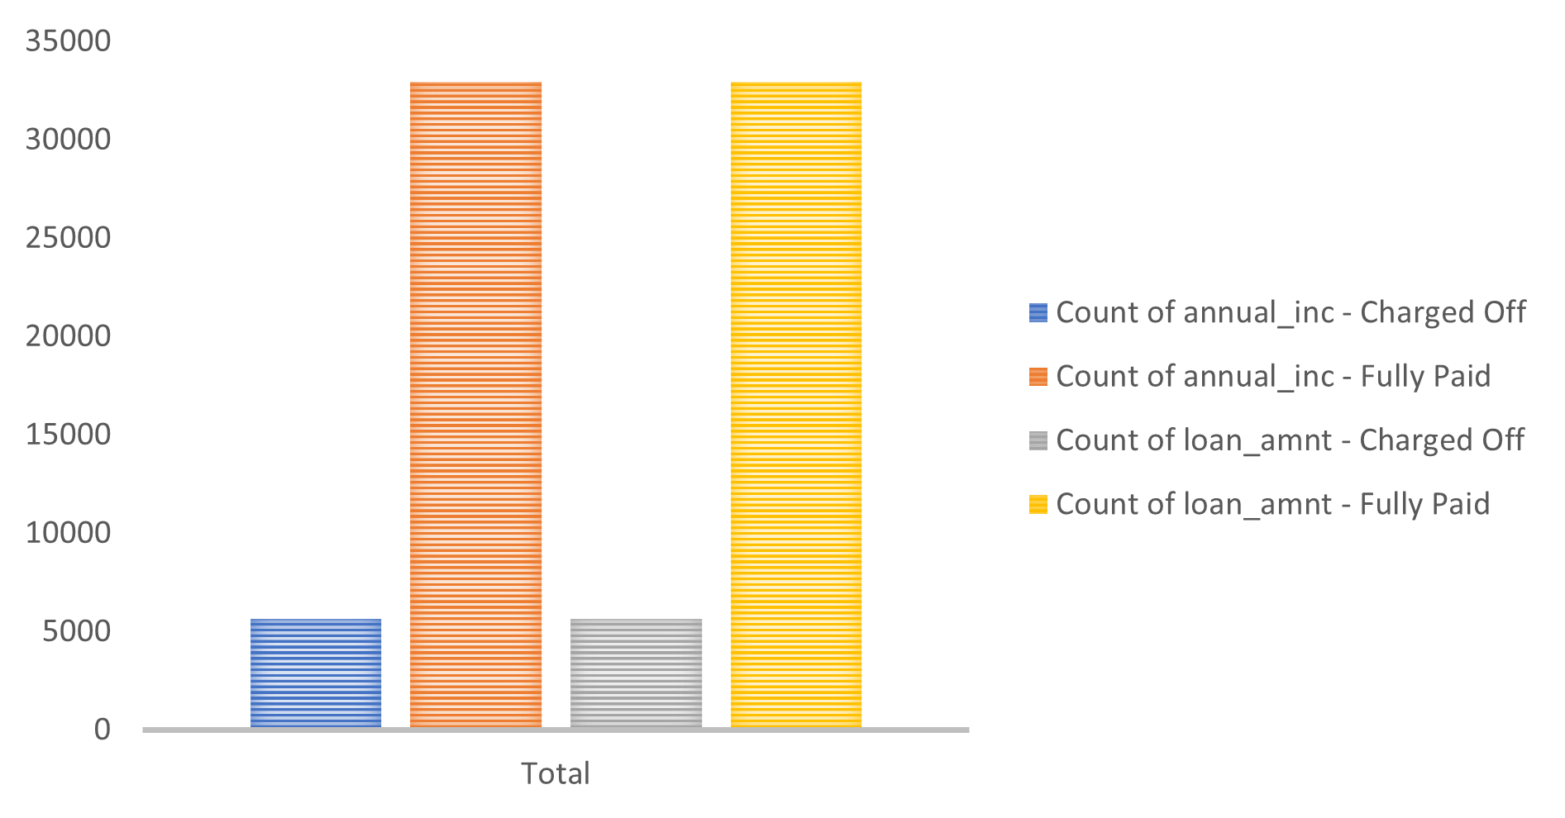
DATA ANALYSIS – ANNUAL INCOME
The customers with higher income are less likely to default.
The annual income reported by the customers ranges from min of 4,000 to max of 6,000,000. Median annual income is around 60,000. Most people have an annual income less than 1,15,000.
There are people with average income lower than 50,000 taking loans of 25,000 or higher. These would be risky loans.

Slide 7
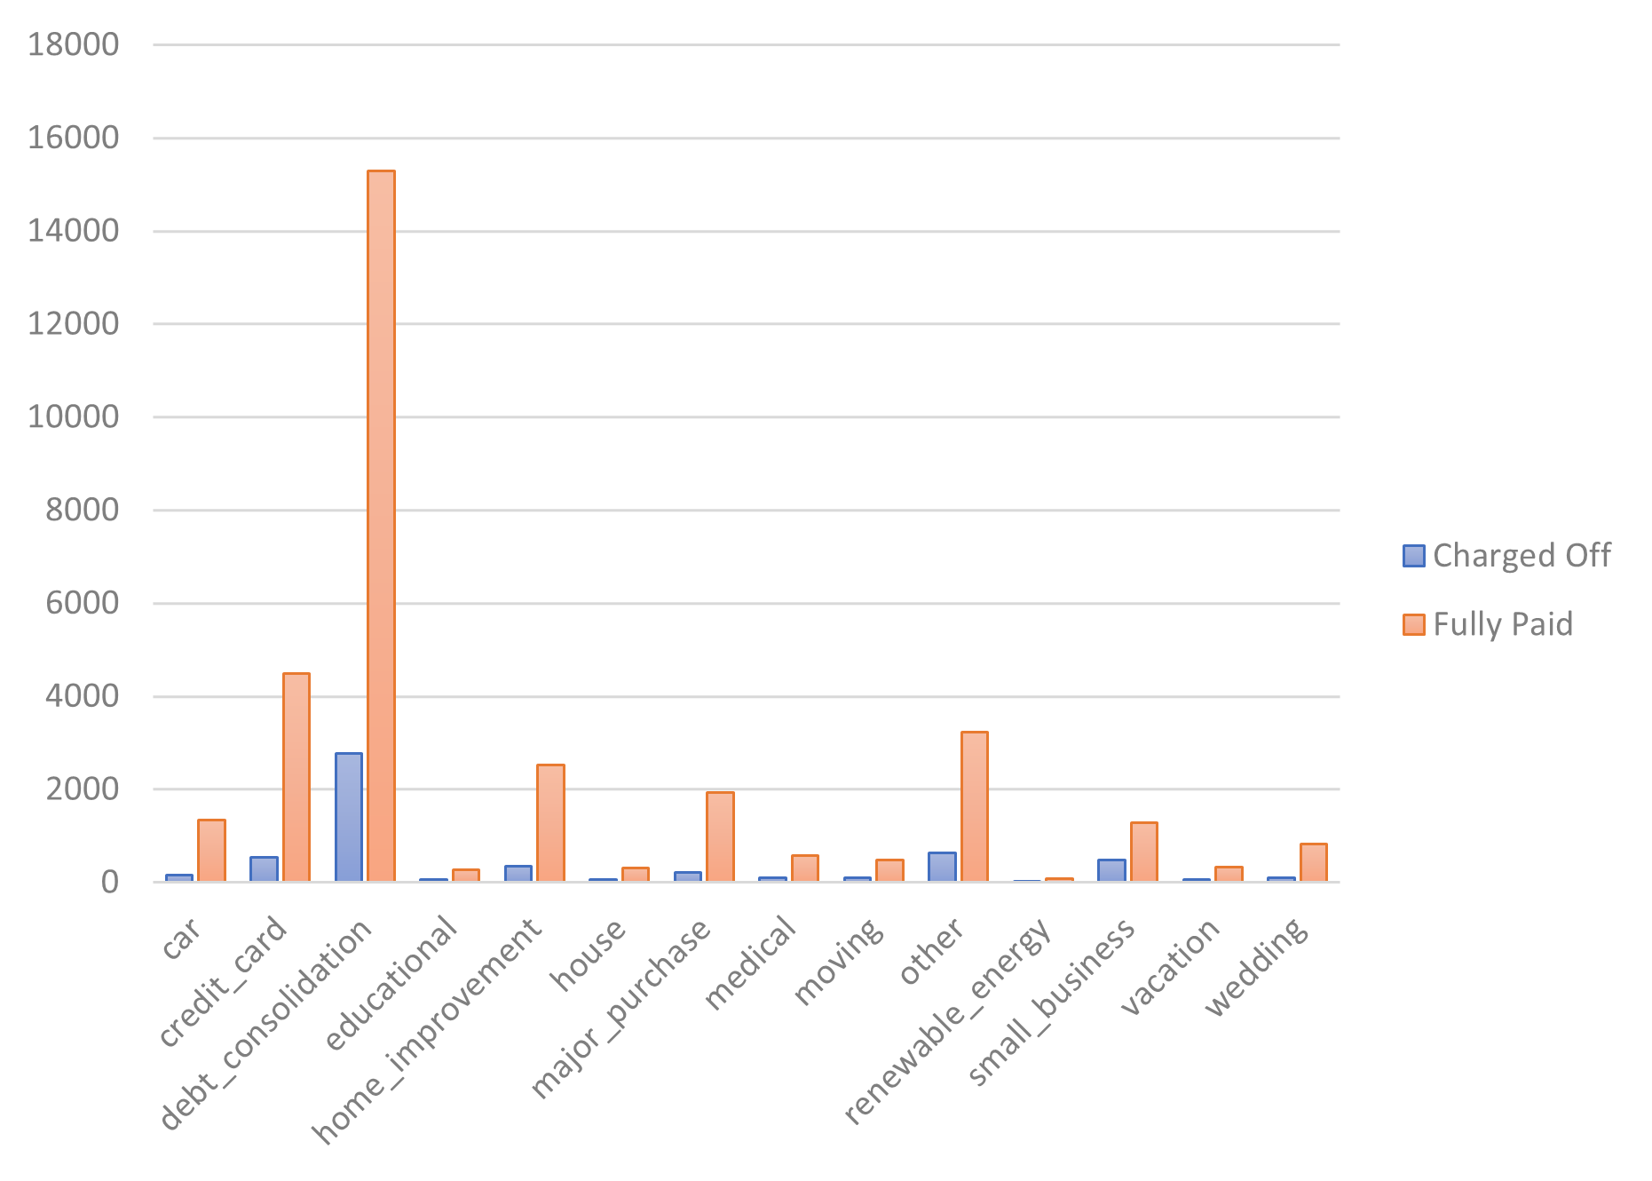
DATA ANALYSIS - PURPOSE
Loan purpose vs Loan status
We see here that the maximum total number of loans approved are for debt consolidation followed by credit card.
We also see that the largest defaulters are for debt consolidation.

Slide 8
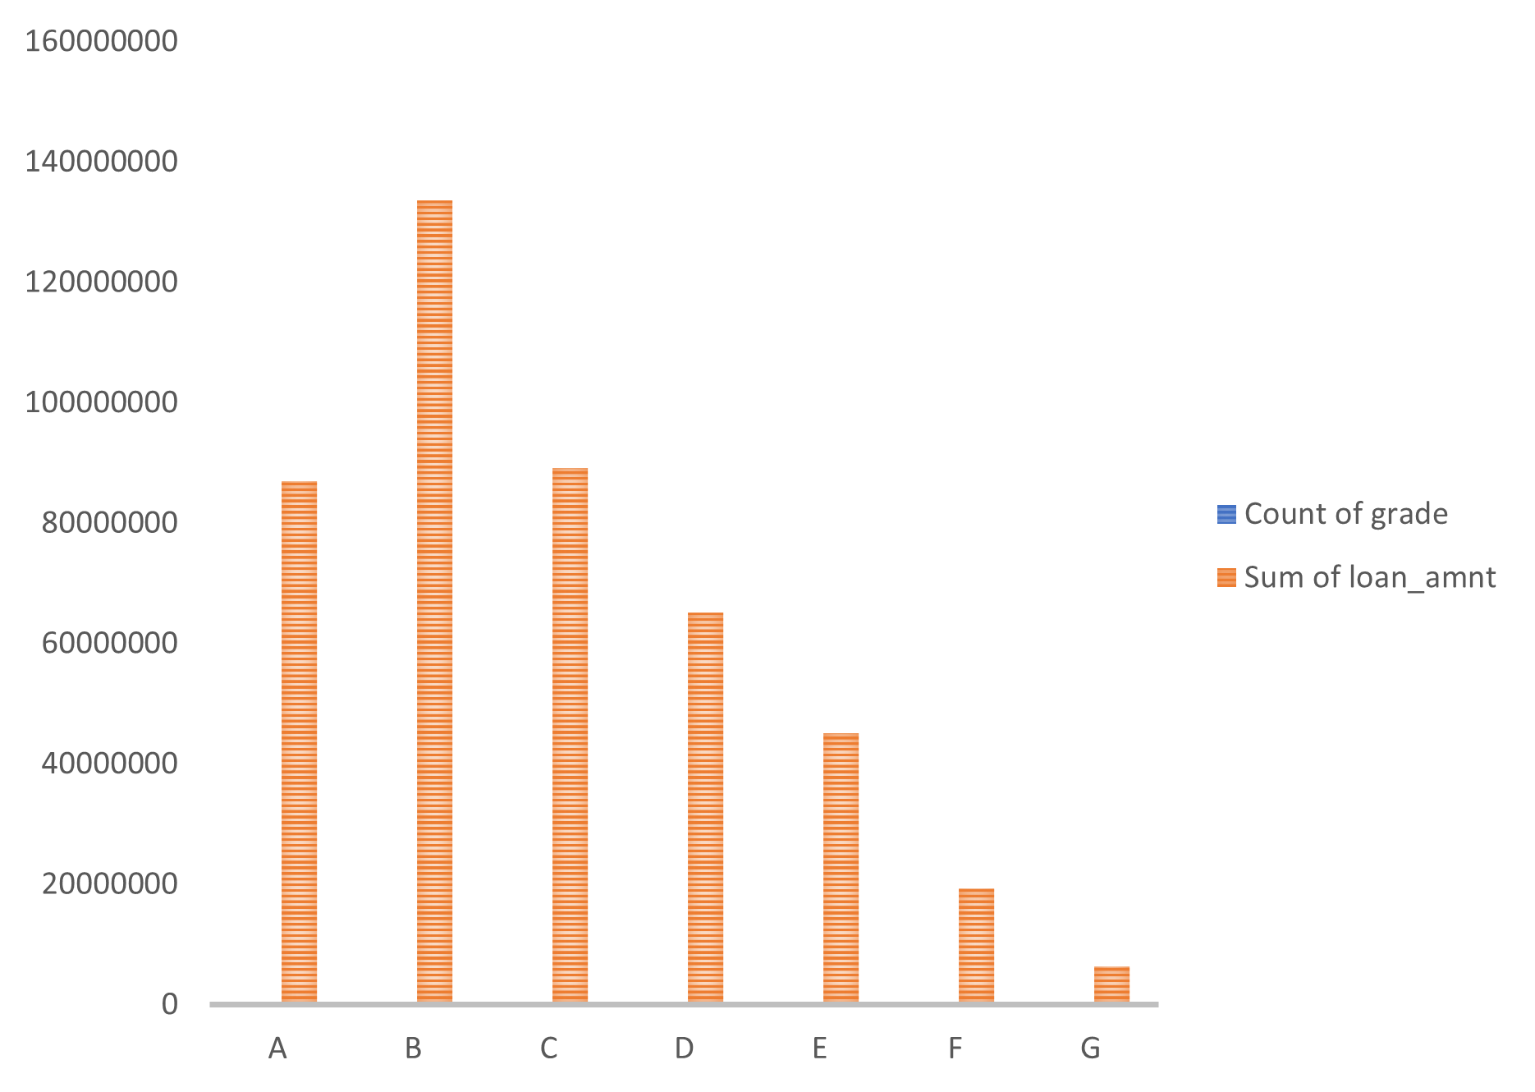
DATA ANALYSIS – GRADE
Loan status vs Grade
Here we see that grade B has the most loan applications.
Loan defaulted is high for grade B and C.

Slide 9
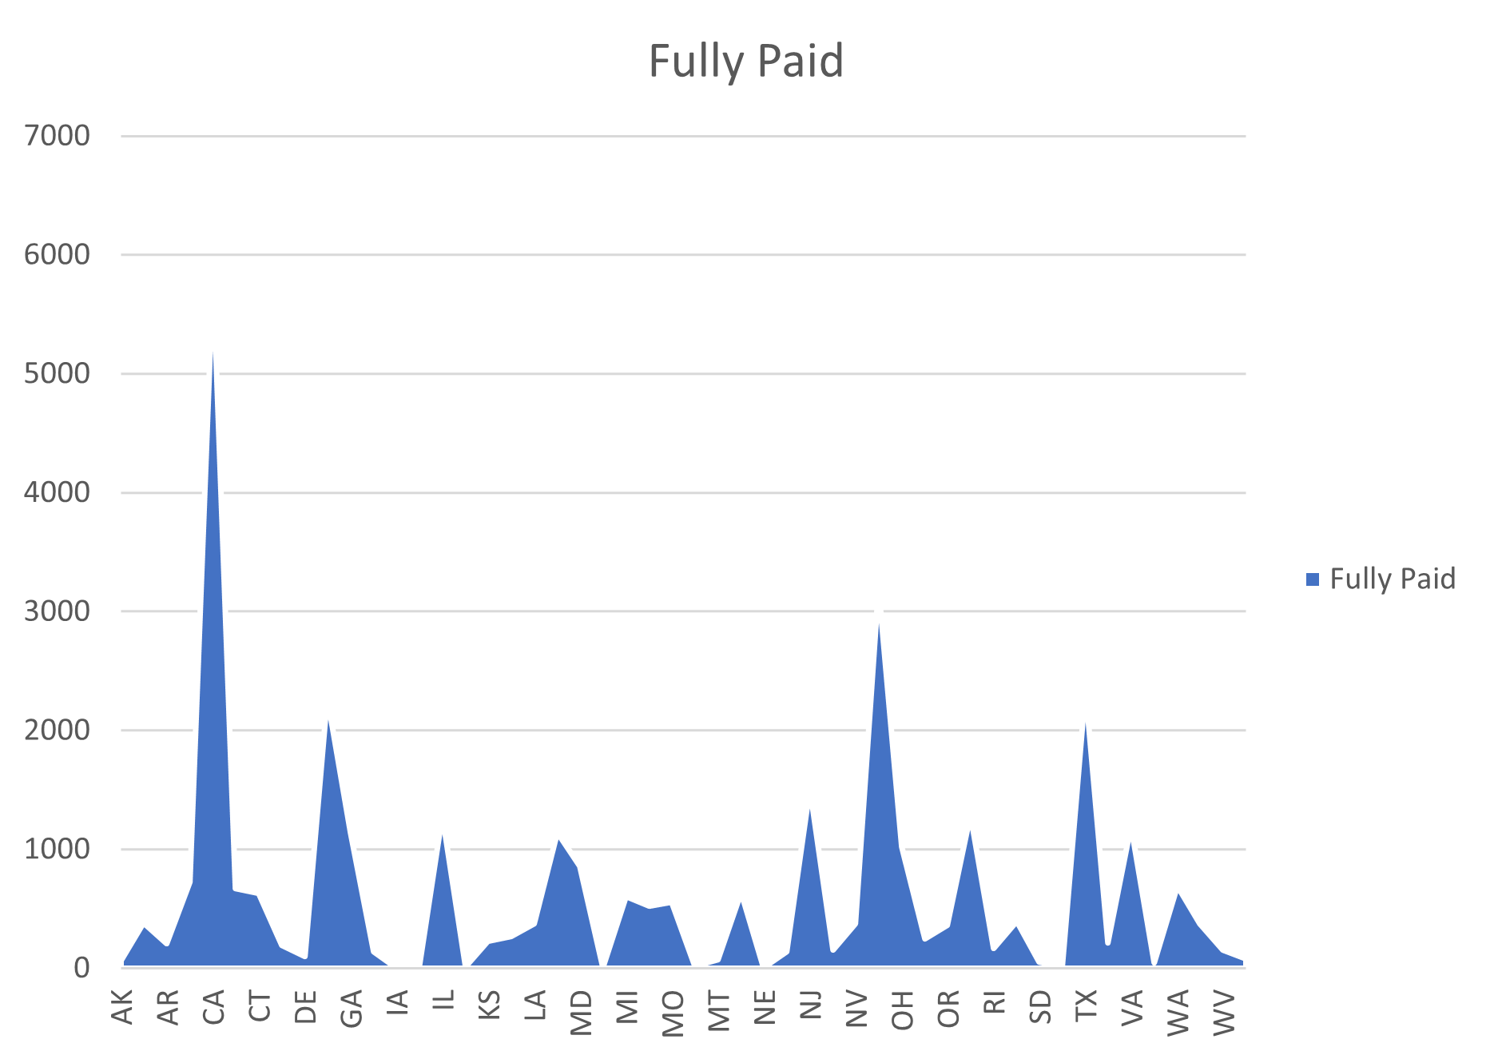
DATA ANALYSIS- STATE
Customers in CA state has most payers and most defaulters.

Slide 10
INSIGHTS
Debt consolidation and small businesses tend to default a loan so be cautious.
Customers having less income with higher loans approved are most likely to default.
Customers from CA state has most payees, and most defaulters so do appropriate verification and background checks.
Loans with higher interest rates can have more defaulters.

